Slide 1
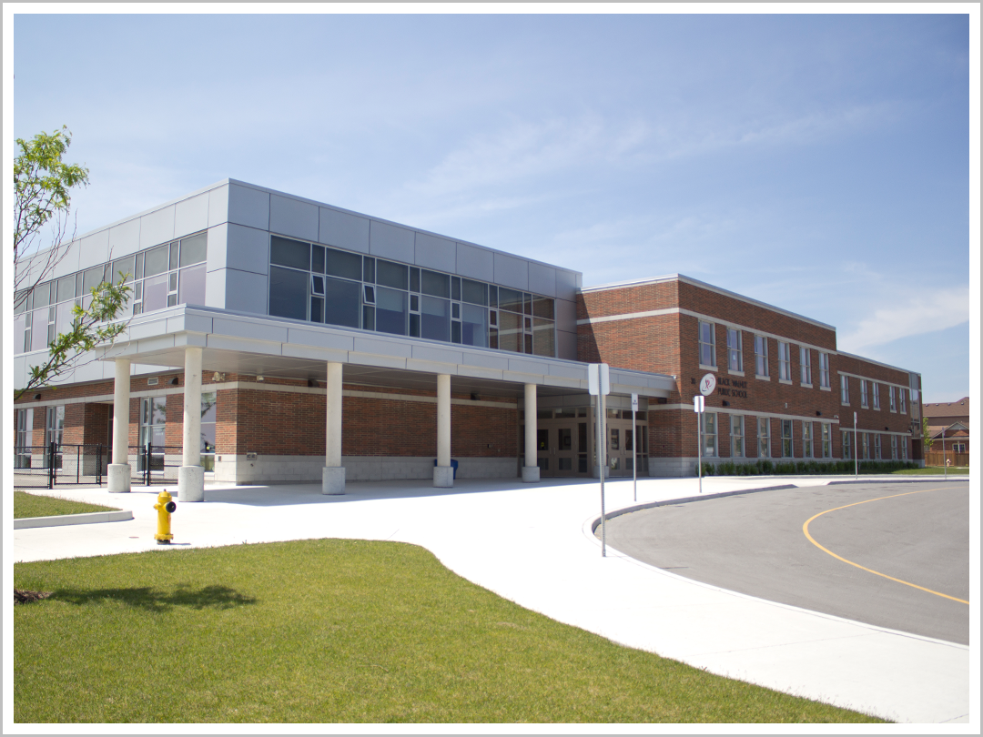

Family Math Night
Black Walnut PS
October 30, 2014
Notes:
Touch on the interest shown by our community to have a night that supports parent understanding of what math programs look like in their child’s classroom.

Slide 2
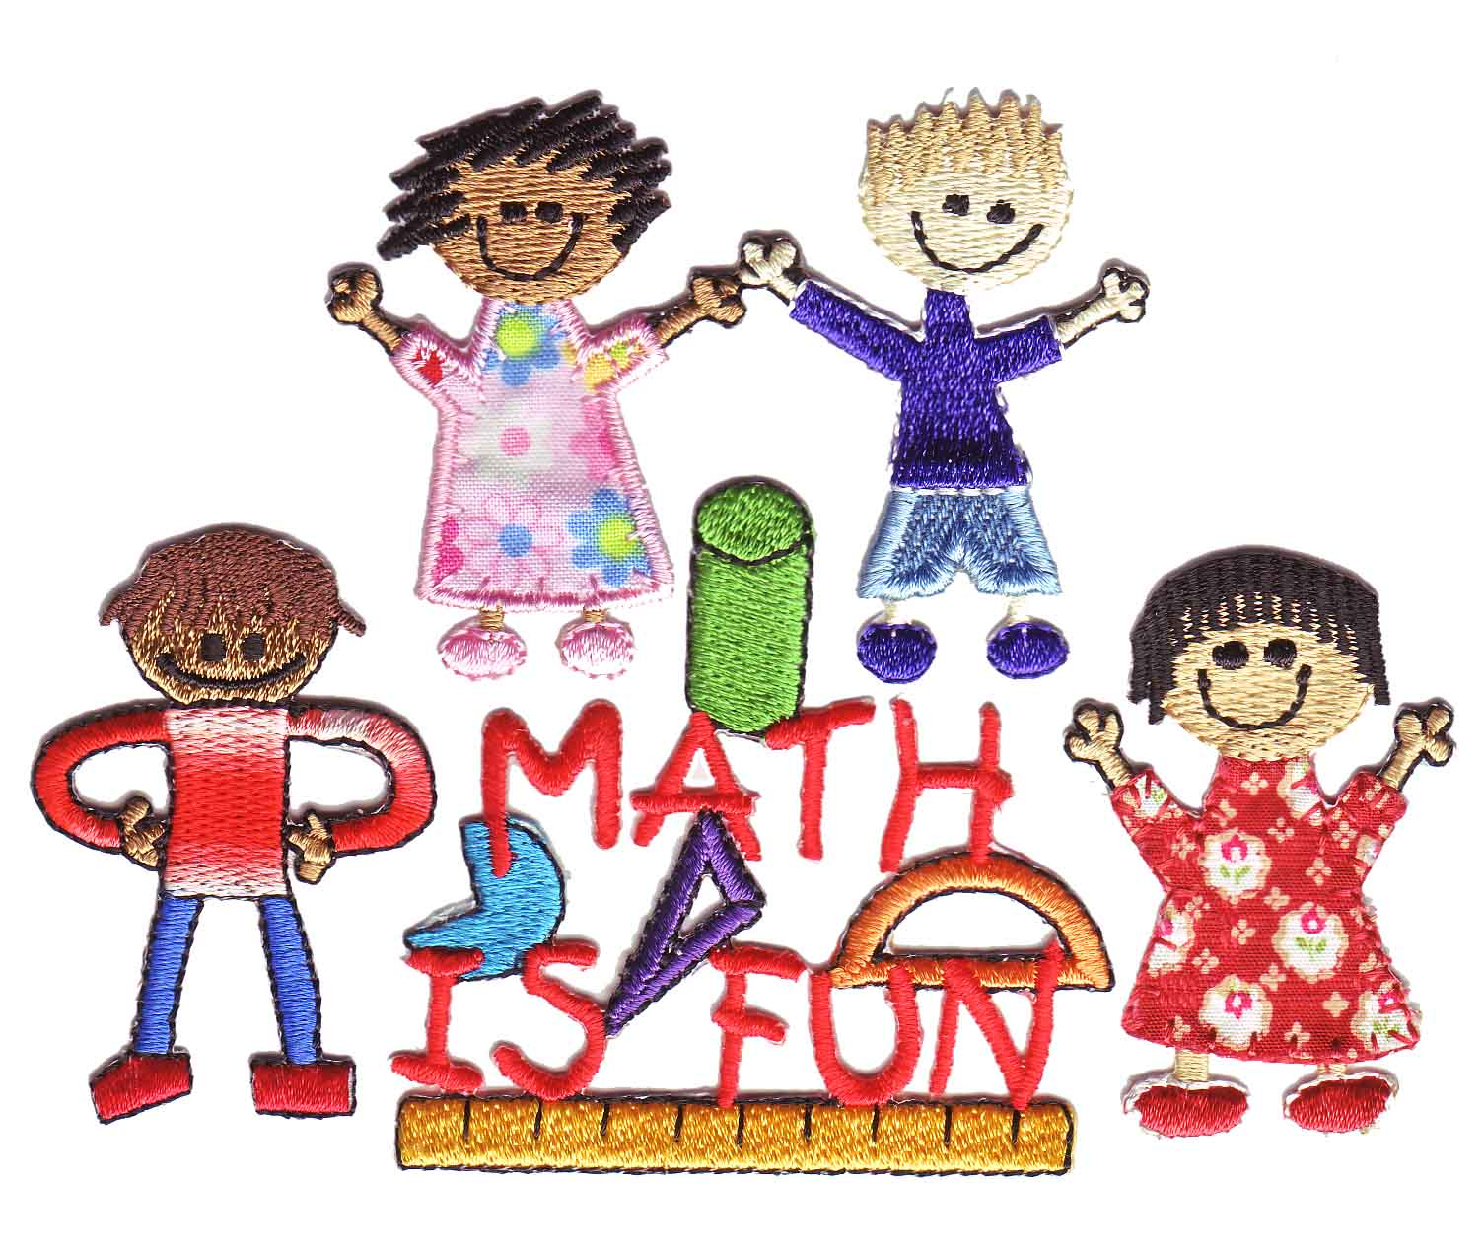
Explore the FUNdamentals
Let’s Work Together!!!

Slide 3
Family Math Night Schedule
Introduction: 6:30pm – 7:00pm
Break out sessions: 7:05pm – 8:00pm
Session #1: 7:05 – 7:25
Transition: 7:25 – 7:30
Session #2: 7:30 – 7:55

Slide 4
Important!!!
Choose 2 of the 5 breakout sessions
If the session you would like to attend is crowded please consider attending another session or waiting until the next session – they are repeated
Refreshments are available in the front hall

Slide 5
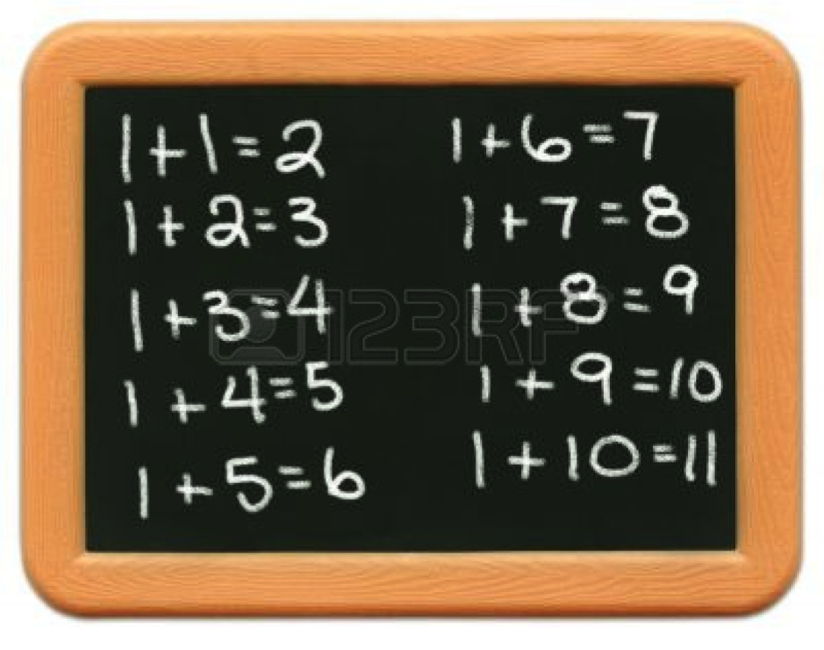
Math education in the past…
Notes:
Discuss the need for the attainment of the foundational math concepts and how these affect further development in math throughout academic years. When students do not have this foundation, they struggle in all areas of mathematics.

Slide 6
MATH IN THE PAST
Only one method for solving problems
Dependent on the textbook for questions and formulas
Encouraged memorization of facts
Focused on getting the one ‘correct’ answer
Led to a lot of “math anxiety”

Slide 7
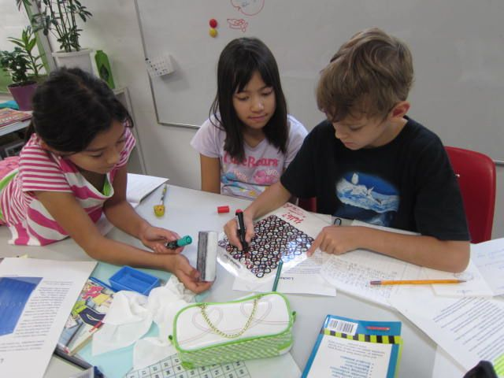
Math Education today…
Notes:
Students are grouped for some of their math in order to begin a math dialogue. Talking through a problem and sharing strategies helps students retain the concepts. Working collaboratively on a problem helps students strengthen social skills, team work skills, builds vocabulary…all while they are immersed in an authentic problem that helps them retain the concepts while engaged in a context they will remember.

Slide 8
Allows students to explore different strategies and to see that there is more than one answer or strategy
Students work collaboratively
Makes authentic connections between classroom ideas and the “real world”
Places an emphasis on the development of mental math and deconstructing number strategies, as well as number relationships
Notes:
This is very different than how we learned math, and allows students to see the many ways to answer problems. In a Math classroom, teachers will be modeling asking effective questions so that students can hear how math dialogue sounds. By modeling different strategies, we are allowing access to more students – there is not only one way to answer a problem
Encourages social skills and critical thinking
Their future will not have a textbook with all of the information and a formula – authentic contexts sets them up for real life experiences
Having a solid foundation in math facts and relationships allows them to access all strands and develops something we call ‘automaticity’ – the ability to automatically recall facts

Slide 9
39 + 17 = ???
40 + 10 + 6
36 + 20
39 + 1 + 6 + 10
30 + 10 + 9 + 7
Notes:
This is an example of how our mind works when adding quickly – this is how we want students to learn. Often, if we learned math at a certain age, parents are teaching vertical addition to children. Although this is helpful on paper, it is not efficient when working in real life. Being able to decompose numbers to ‘friendlier’ pieces and regroup helps us to add quickly and efficiently

Slide 10

“Math Class Needs a Makeover”
Ted Talk – Dan Meyer
Notes:
http://www.ted.com/talks/dan_meyer_math_curriculum_makeover.html
http://blog.mrmeyer.com/

Slide 11
Achievement Chart for Mathematics
Categories of The Achievement Chart
Knowledge and Understanding | Thinking
- Knowledge of content - Understanding of mathematical concepts | - Use of planning skills Use of processing skills - Use of critical/creative thinking processes
Communication | Application
- Expression and organization of ideas and mathematical thinking - Communication for different audiences and purposes - Use of conventions, vocabulary, and terminology | Application of knowledge and skills in familiar contexts - Transfer of knowledge and skills to new contexts - Making connections within and between various contexts
Notes:
Brief facts about how teachers mark in four categories…not just if the question is ‘right’

Slide 12
Assessment in Mathematics:
Triangulation of Data
Conversations
Observations
Products
Notes:
Again – brief info re how it is not just the written product that makes a mark…much of what students do and say in the classroom shows us their understanding. Also – a point that the critical thinking that is observed through their partner work and when answering questions sometimes shows a much deeper understanding than any piece of paper could

Slide 13
Inquiry Based Mathematics Instruction
Starts with an engaging question
Enables students to work cooperatively
Emphasizes process over product
Allows teachers to redirect with key questions and not answers
Often uses a 3 part lesson format with a “Math Congress” or “Gallery walk” afterwards
Notes:
A brief outline of what the 3 parts are. Let parents know that they will see more of what this looks like if they signed up for a break out session re the 3 part lesson

Slide 14
Problem Solving in Mathematics
Promotes critical thinking
Allows for cross-curricular integration
Should often be open ended
Encourages students to follow specific models
Uses different strategies for a variety problems
Notes:
Recap

Slide 15
How can parents help their children?
Accept that you do not need to know everything about math; helping your children is more about supporting them and asking the right questions
Understand that there are different strategies to reach a solution
Believe that your child can be successful in solving math problems
Notes:
Helping your child can be listening to your child’s math reasoning and asking questions that help them think more deeply
This may take some getting used to depending on your own education, but is so important for your child
Confidence is one of the biggest road blocks in learning – celebrate successes and achievements…regardless of how big or small they are

Slide 16
Recognize that memorizing math facts is important, but is only part of being a competent math student
Look at the relationships between numbers (e.g. 9+6 is like 10+5)
Value the mathematical processes (how your child got to an answer) and not just the correct answers
Celebrate effort and perseverance
See and embrace math in everyday “real life” situations

Slide 17

Thanks for coming to BWPS Family Math Night!

Slide 18
Breakout Sessions
Kindergarten – 125
Primary Games – 223
Junior Games – 228
Critical Thinking (All Grades) – 219
Intermediate – 204
Remember – You can choose 2 ☺

